Slide 1
Lesson 04.03 - Internet Protocol
Aim: How does the internet protocol use abstraction?

Slide 2
IP Addresses use binary numbers

Slide 3
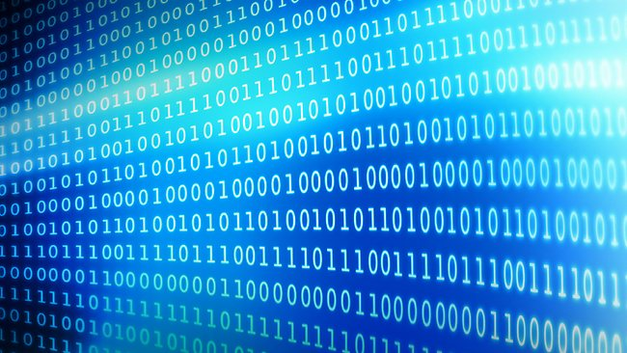
Binary

Slide 4
Lesson 04.03: Objectives
Aim:
What is binary and why do computers use it?
What is a bit?
Skills:
Translation of decimals & binary.

Slide 5
What is binary?

Slide 6
What is binary?
A way of representing numbers using only two digits: 1 and 0.

Slide 7
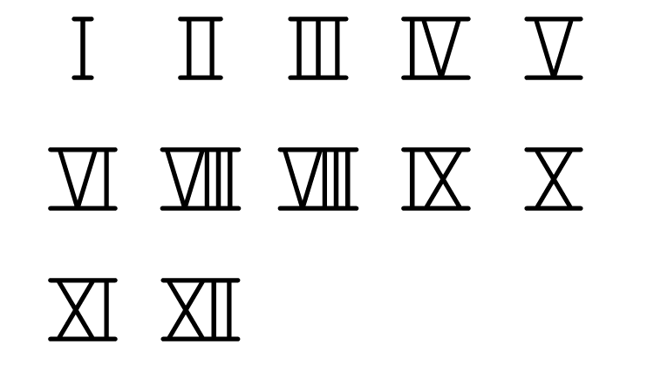
Roman Numerals
Tick Marks
Decimal Numbers
1 2 3 4 5 6 7 8 9 10 11

Slide 8
Why Use Binary?

Slide 9
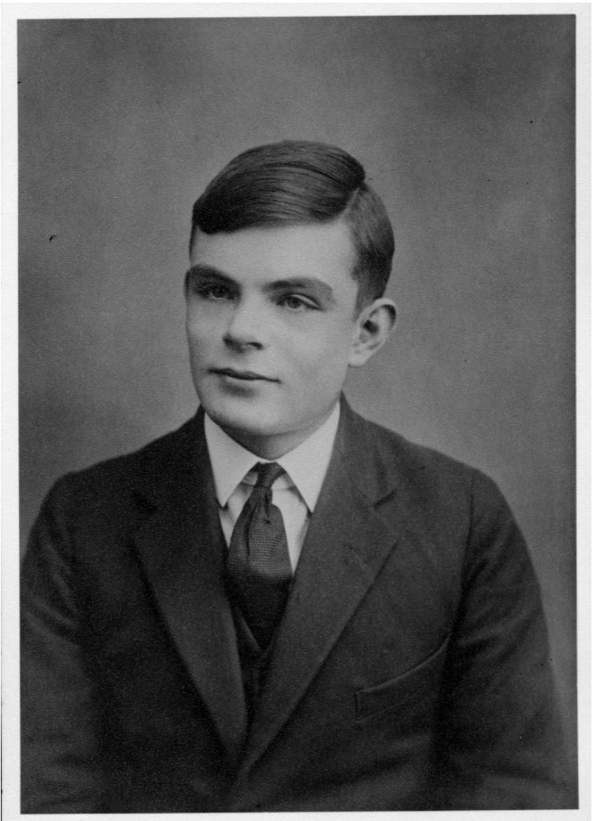
Why Use Binary?
Alan Turing showed that any function can be described by adding and subtracting binary numbers.

Slide 10
Why Use Binary?
Computers are physical machines that store and process electricity.
In every part of the machine, electricity flows through or it doesn’t flow through.
We interpret the presence of electricity as 1 and the absence of electricity as 0.

Slide 11
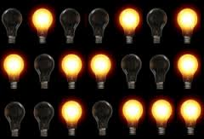
Why Use Binary?
0
1
0
0
1
0
1
1
0
1
1
0
0
1
0
0
1
0
1
1
1

Slide 12

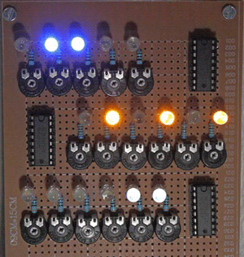



Why Use Binary?

Slide 13

Translating Binary to Decimal

Slide 14
Step 0: Make 8 Columns

Slide 15
Step 1: Make 4 Rows

Slide 16
Step 2: Powers of 2 in 2nd Row
2⁷ | 2⁶ | 2⁵ | 2⁴ | 2³ | 2² | 2¹ | 2⁰

Slide 17
Step 3: Value of Powers of 2 in 1st Row
2⁷ | 2⁶ | 2⁵ | 2⁴ | 2³ | 2² | 2¹ | 2⁰

Slide 18
Step 3: Value of Powers of 2 in 1st Row
128 | 64 | 32 | 16 | 8 | 4 | 2 | 1
2⁷ | 2⁶ | 2⁵ | 2⁴ | 2³ | 2² | 2¹ | 2⁰

Slide 19
Step 4: 0’s in 3rd Row
128 | 64 | 32 | 16 | 8 | 4 | 2 | 1
2⁷ | 2⁶ | 2⁵ | 2⁴ | 2³ | 2² | 2¹ | 2⁰
0 | 0 | 0 | 0 | 0 | 0 | 0 | 0

Slide 20

Step 5: Cut Columns in Last Row
128 | 64 | 32 | 16 | 8 | 4 | 2 | 1
2⁷ | 2⁶ | 2⁵ | 2⁴ | 2³ | 2² | 2¹ | 2⁰
0 | 0 | 0 | 0 | 0 | 0 | 0 | 0

Slide 21
Step 5: 1’s on Back of Bottom Row
128 | 64 | 32 | 16 | 8 | 4 | 2 | 1
2⁷ | 2⁶ | 2⁵ | 2⁴ | 2³ | 2² | 2¹ | 2⁰
0 | 0 | 0 | 0 | 0 | 0 | 0 | 0
1

Slide 22
Step 5: 1’s on Back of Bottom Row
128 | 64 | 32 | 16 | 8 | 4 | 2 | 1
2⁷ | 2⁶ | 2⁵ | 2⁴ | 2³ | 2² | 2¹ | 2⁰
0 | 0 | 0 | 0 | 0 | 0 | 0 | 0
1
1

Slide 23
Step 5: 1’s on Back of Bottom Row
128 | 64 | 32 | 16 | 8 | 4 | 2 | 1
2⁷ | 2⁶ | 2⁵ | 2⁴ | 2³ | 2² | 2¹ | 2⁰
0 | 0 | 0 | 0 | 0 | 0 | 0 | 0
1
1
1

Slide 24
Step 5: 1’s on Back of Bottom Row
128 | 64 | 32 | 16 | 8 | 4 | 2 | 1
2⁷ | 2⁶ | 2⁵ | 2⁴ | 2³ | 2² | 2¹ | 2⁰
0 | 0 | 0 | 0 | 0 | 0 | 0 | 0
1
1
1
1
1
1
1
1

Slide 25
How does this work?
128 | 64 | 32 | 16 | 8 | 4 | 2 | 1
2⁷ | 2⁶ | 2⁵ | 2⁴ | 2³ | 2² | 2¹ | 2⁰
0 | 0 | 0 | 0 | 0 | 0 | 0 | 0
1

Slide 26
Q0) Represent ten in binary.
128 | 64 | 32 | 16 | 8 | 4 | 2 | 1
2⁷ | 2⁶ | 2⁵ | 2⁴ | 2³ | 2² | 2¹ | 2⁰
0 | 0 | 0 | 0 | 0 | 0 | 0 | 0

Slide 27
Q0) 10 = ?
128 | 64 | 32 | 16 | 8 | 4 | 2 | 1
2⁷ | 2⁶ | 2⁵ | 2⁴ | 2³ | 2² | 2¹ | 2⁰
0 | 0 | 0 | 0 | 0 | 0 | 0 | 0

Slide 28
Q0) 10 = 8 + ?
128 | 64 | 32 | 16 | 8 | 4 | 2 | 1
2⁷ | 2⁶ | 2⁵ | 2⁴ | 2³ | 2² | 2¹ | 2⁰
0 | 0 | 0 | 0 | 0 | 0 | 0 | 0
1

Slide 29
Q0) 10 = 8 + 2
128 | 64 | 32 | 16 | 8 | 4 | 2 | 1
2⁷ | 2⁶ | 2⁵ | 2⁴ | 2³ | 2² | 2¹ | 2⁰
0 | 0 | 0 | 0 | 0 | 0 | 0 | 0
1
1

Slide 30
A0) Ten in binary is 1010!
128 | 64 | 32 | 16 | 8 | 4 | 2 | 1
2⁷ | 2⁶ | 2⁵ | 2⁴ | 2³ | 2² | 2¹ | 2⁰
0 | 0 | 0 | 0 | 0 | 0 | 0 | 0
1
1

Slide 31
Q1) Represent seventy one in binary.
128 | 64 | 32 | 16 | 8 | 4 | 2 | 1
2⁷ | 2⁶ | 2⁵ | 2⁴ | 2³ | 2² | 2¹ | 2⁰
0 | 0 | 0 | 0 | 0 | 0 | 0 | 0

Slide 32
Q1) 71 = ?
128 | 64 | 32 | 16 | 8 | 4 | 2 | 1
2⁷ | 2⁶ | 2⁵ | 2⁴ | 2³ | 2² | 2¹ | 2⁰
0 | 0 | 0 | 0 | 0 | 0 | 0 | 0

Slide 33
Q1) 71 = 64 + ?
128 | 64 | 32 | 16 | 8 | 4 | 2 | 1
2⁷ | 2⁶ | 2⁵ | 2⁴ | 2³ | 2² | 2¹ | 2⁰
0 | 0 | 0 | 0 | 0 | 0 | 0 | 0
1

Slide 34
Q1) 71 = 64 + 4 + ?
128 | 64 | 32 | 16 | 8 | 4 | 2 | 1
2⁷ | 2⁶ | 2⁵ | 2⁴ | 2³ | 2² | 2¹ | 2⁰
0 | 0 | 0 | 0 | 0 | 0 | 0 | 0
1
1

Slide 35
Q1) 71 = 64 + 4 + 2 + ?
128 | 64 | 32 | 16 | 8 | 4 | 2 | 1
2⁷ | 2⁶ | 2⁵ | 2⁴ | 2³ | 2² | 2¹ | 2⁰
0 | 0 | 0 | 0 | 0 | 0 | 0 | 0
1
1
1

Slide 36
Q1) 71 = 64 + 4 + 2 + 1
128 | 64 | 32 | 16 | 8 | 4 | 2 | 1
2⁷ | 2⁶ | 2⁵ | 2⁴ | 2³ | 2² | 2¹ | 2⁰
0 | 0 | 0 | 0 | 0 | 0 | 0 | 0
1
1
1
1

Slide 37
Q1) 71 = 64 + 4 + 2 + 1
128 | 64 | 32 | 16 | 8 | 4 | 2 | 1
2⁷ | 2⁶ | 2⁵ | 2⁴ | 2³ | 2² | 2¹ | 2⁰
0 | 0 | 0 | 0 | 0 | 0 | 0 | 0
1
1
1
1

Slide 38
A1) Seventy one in binary is 1000111
128 | 64 | 32 | 16 | 8 | 4 | 2 | 1
2⁷ | 2⁶ | 2⁵ | 2⁴ | 2³ | 2² | 2¹ | 2⁰
0 | 0 | 0 | 0 | 0 | 0 | 0 | 0
1
1
1
1

Slide 39
Q2) Represent 0b1010101 in decimal.
128 | 64 | 32 | 16 | 8 | 4 | 2 | 1
2⁷ | 2⁶ | 2⁵ | 2⁴ | 2³ | 2² | 2¹ | 2⁰
0 | 0 | 0 | 0 | 0 | 0 | 0 | 0

Slide 40
Q2) 0b1010101 = 64 + 16 + 4 + 1
128 | 64 | 32 | 16 | 8 | 4 | 2 | 1
2⁷ | 2⁶ | 2⁵ | 2⁴ | 2³ | 2² | 2¹ | 2⁰
0 | 0 | 0 | 0 | 0 | 0 | 0 | 0
1
1
1
1

Slide 41
A2) 0b1010101 = 85
128 | 64 | 32 | 16 | 8 | 4 | 2 | 1
2⁷ | 2⁶ | 2⁵ | 2⁴ | 2³ | 2² | 2¹ | 2⁰
0 | 0 | 0 | 0 | 0 | 0 | 0 | 0
1
1
1
1

Slide 42
Binary to Decimal Self Check
Q3) Represent 1 in binary.
Q4) Represent 15 in binary.
Q5) Represent 234 in binary.
Q6) Represent 0b1110 in decimal.
Q7) Represent 0b101 in decimal.
Q8) Represent 0b11 in decimal.
Q9) What is the largest decimal number that can be represented in binary with 8 bits?

Slide 43
Binary to Decimal Self Check
Q3) Represent 1 in binary…………….. 1
Q4) Represent 15 in binary………. 1111
Q5) Represent 234 in binary………11101010
Q6) Represent 0b1110 in decimal... 14
Q7) Represent 0b101 in decimal.... 5
Q8) Represent 0b11 in decimal..…. 3

